Slide 1

EDA on mutual funds
Gourav Kumar Verma
Data Science, Bellevue University
DSC530-T302, Data Exploration and Analysis
Feb. 28, 2020
Notes:
NOTE:
To change the image on this slide, select the picture and delete it. Then click the Pictures icon in the placeholder to insert your own image.

Slide 2
Contents
Introduction
Hypothetical Questions
Important Variables
Exploratory Data Analysis
Histograms
CDF
Scatter Plot
Modeling/Prediction
Conclusion

Slide 3
Introduction
A mutual fund is a company that pools money from many investors and invests the money in securities such as stocks, bonds, and short-term debt. The combined holdings of the mutual fund are known as its portfolio. Investors buy shares in mutual funds. Each share represents an investor’s part ownership in the fund and the income it generates.
There are many parameters and points attached to a Mutual Funds. In this project I will be putting my focus on important factors tied to a high performing Mutual funds.

Slide 4
Statistical/Hypothetical Question
How fund return is related to other factors and what are the important factors for good return?
Does expense ratio plays important role in Mutual Fund’s performance?
How the size of the fund affects its performance?
What is the investment sector distribution of high performing funds?
How is the distribution of portfolio of high performing funds?
Is Morningstar_rating, MorningStar_return_rating and Morningstar_risk_rating worth considering for Mutual Fund investment?

Slide 5
Important Variables
net_assets : It represents the total of all dollars invested in all share classes of the fund. Do not confuse it with Net Asset Value(NAV, per share/unit price of the fund)
morningstar_rating : The Morningstar Rating is a measure of a fund's risk-adjusted return, relative to similar funds. Funds are rated from 1 to 5 stars, with the best performers receiving 5 stars and the worst performers receiving a single star
net_annual_expense_ratio_fund : The expense ratio is the annual fee that all funds charge their shareholders
investment : Classification of funds based on both the size of the companies invested in and the growth prospects of the invested stocks.
size : Size of fund. Large, Medium, Small
fund_return_2018 : profit generated in year 2018
fund_return_10years : profit generated in past 10 year

Slide 6
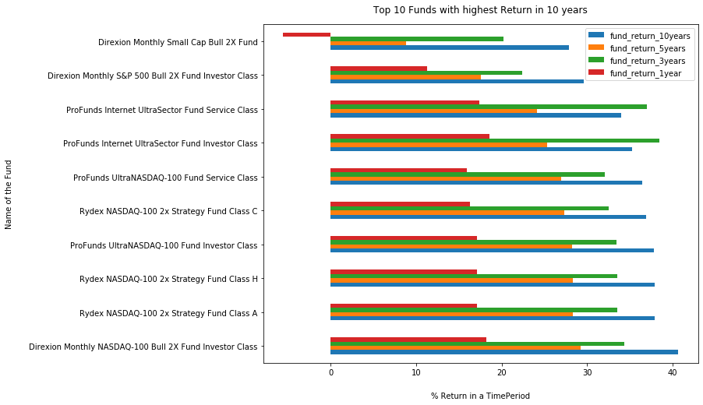
Top 10 funds with highest return in 10 years

Slide 7
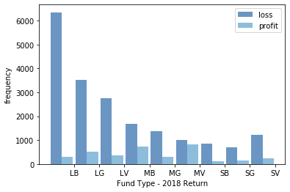
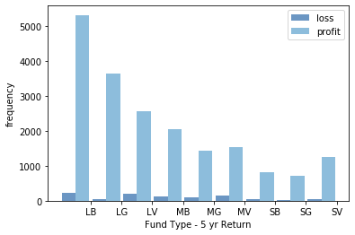
Profit/Loss Histogram on 2018 Return and 5 Years Return
Histogram of comparison of profit/loss based on fund type for 2018 and tenure of 5years. It clearly shows that most of the fund’s returns converted into profit if the investment went for past 5 years instead of just a year. The more time you invest in Large Blend funds, more chances of having the profit.

Slide 8
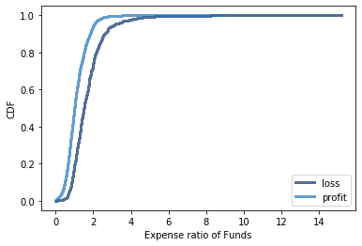
CDF of profit/loss expense ratio on 5 Year Return
CDF gives more clearer difference of expense ratio between profit funds and loss funds. We can see expense ratio of profit funds are lower between 0 to 3.
We can conclude that in 5 years funds with lower expense ratio gave more profit.

Slide 9
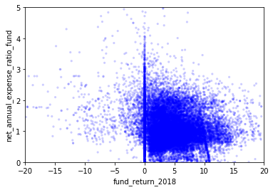
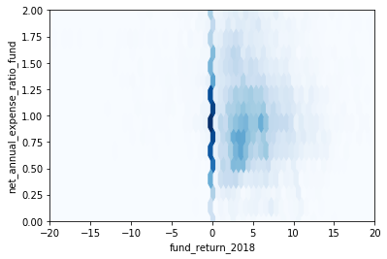
Scatter Plots
Scatter plot between expense ratio and 5year return shows non-linear relationship.
However, hexbin plot shows that funds having expense ratio between 0.5-1.0 yield 0-5% positive return in 5 years.
Figure 1 : Scatter plot
Figure 2 : Hexbin Plot

Slide 10
Modeling and Prediction
fund_return_10years ~ morningstar_rating + net_assets + price_earnings
Dep. Variable: | fund_return_10years | R-squared: | 0.220
Model: | OLS | Adj. R-squared: | 0.220
Method: | Least Squares | F-statistic: | 2357.
Date: | Sat, 29 Feb 2020 | Prob (F-statistic): | 0.00
Time: | 15:16:11 | Log-Likelihood: | -79559.
No. Observations: | 25073 | AIC: | 1.591e+05
Df Residuals: | 25069 | BIC: | 1.592e+05
Df Model: | 3
Covariance Type: | nonrobust
 | coef | std err | t | P>|t| | [0.025 | 0.975]
Intercept | -0.4120 | 0.099 | -4.152 | 0.000 | -0.607 | -0.218
morningstar_rating | 1.3287 | 0.029 | 46.038 | 0.000 | 1.272 | 1.385
net_assets | 2.807e-05 | 2.02e-06 | 13.908 | 0.000 | 2.41e-05 | 3.2e-05
price_earnings | 0.2584 | 0.004 | 63.176 | 0.000 | 0.250 | 0.266
Omnibus: | 1846.441 | Durbin-Watson: | 1.294
Prob(Omnibus): | 0.000 | Jarque-Bera (JB): | 3644.826
Skew: | -0.512 | Prob(JB): | 0.00
Kurtosis: | 4.562 | Cond. No. | 5.17e+04
As per our model there will be 9.3% 10year return on a 200 million dollar fund, whose morning star rating is 4 and price to earnings ratio is 17.0

Slide 11
Conclusions
Morning Star rating has significant impact on funds performance. Higher the rating higher the return.
The more time you invest in Large Blend funds, more chances of having the profit.
Profit proving funds has comparatively lower expense ratio than that of funds in loss.
Majority of funds with Expense ratio between 0.5-1.0 yield 0-5% positive return in 5 years.

Slide 12
Thank You..!

